Slide 1
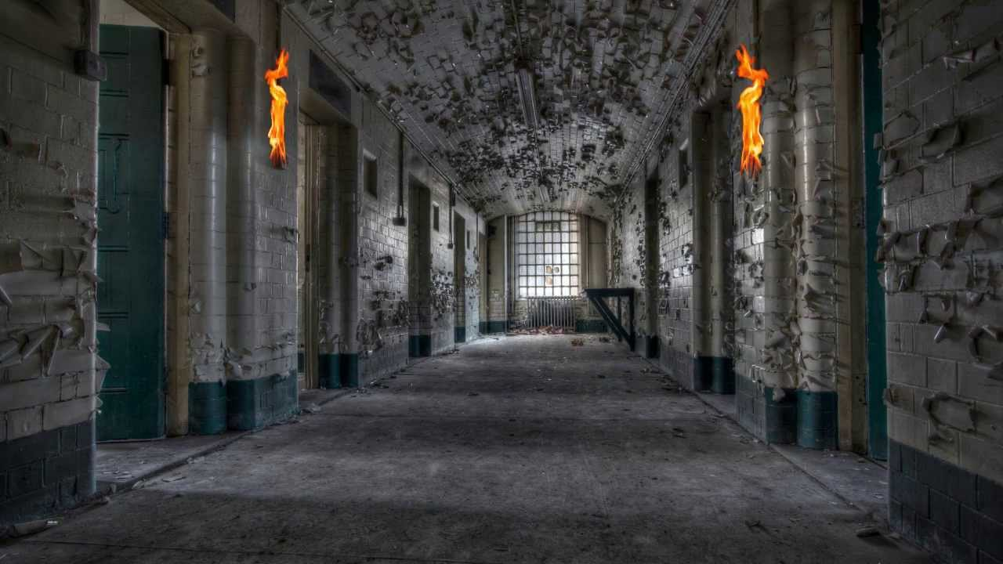
Jailbreak Kryptix Incorporations
By: Mia Wu, Roy Lu, Kennen Romero, and Nicholas Edelson
Notes:
This is Kryptix Incorporation’s newly developed game(work in progress), known as “JAIL BREAK!!”

Slide 2




OH Great! I’m stuck at another stupid attempt to keep me from escaping. How stupid! Do they have no idea who they are messing with? IT’S BEEN FUN, NOT REALLY, BUT IT’S TIME TO LEAVE. Help me escape from this dreadful place?
Continue
Ask what’s going on?
Notes:
You are Jack Wellington, a well-known escapist of confinement. Due to you reputation, you are transported to Essex, but have no recollection of it, for you were drugged and left unconscious. You then wake up in a cell, confused about where you are…. you realize that once again, you are dumped into a jail and must escape.

Slide 3








LEVEL 1
H
Notes:
Regain your lost freedom by passing through moving obstacles, all the while guards are on the lookout. But if you get caught by a guard, you will be sent back to your cell. You can do this by utilizing the left and right arrow keys to maneuver your avatar around the guards to reach the exit, allowing you to move onto the next level.

Slide 4

Notes:
However, it won’t be that easy, for there will be guards looking out for you and you must avoid the touch of these guards, otherwise, they will decrease your hearts. But that isn’t the only challenge you will face throughout the game. This is one of two possible conclusion of either passing the level or failing and restarting from the beginning.

Slide 5

…..
*Health -2*
Notes:
You are given the option, therefore not mandatory, but if you want to give your character an advantage and preserve your life, you can try to obtain the coins located in different locations of the platforms. But you are giving yourself a risk, where you have to avoid spikes to reach the powerup. By obtaining the power, you can gain more chances at surviving the jail and escaping.

Slide 6
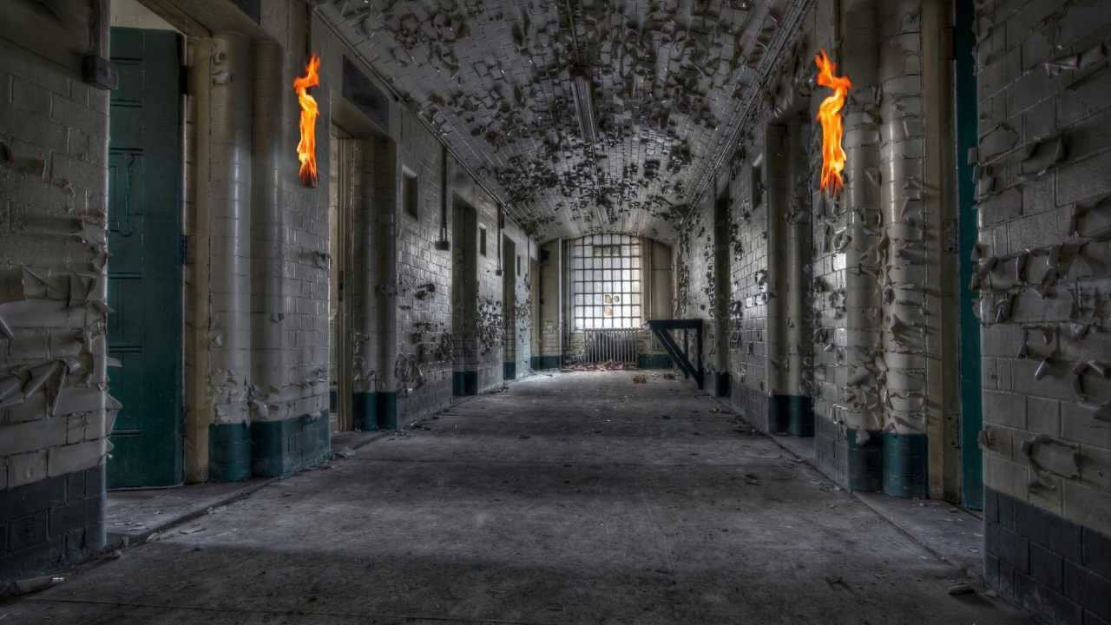

LEVEL 2
Notes:
Once you successfully beaten the so-called boss of the first level, you need to have a certain amount of hearts to move onto the next level. As you advance with each level, you will come across more advanced guards and a increase in the difficulty.

Slide 7

LEVEL 3
Notes:
Level 3 is the more advanced and the last stage before you can escape. But despite the carefree looking boss, they are the most powerful of the bunch and you have to defeat them.

Slide 8


How many security guards did this place draft? Either way, I can see the light to the exit, the actual one. Every time I thought I saw the exit, it was a door to the next level! Finally, I’ll see the outside world! THANKS FOR PLAYING!!
Notes:
Once you have past all the guards, you can finally leave the jail, as you see light to signify the exit, the true exit to escape the jail cell once and for all.

Slide 9

Notes:
Nonetheless, if you lose and don’t manage to defeat the last boss, then you are captured and returned to your cell, where you have to start from the beginning.

